Slide 1
Unit 5: Ambition
Lesson 5A: Vocabulary

Slide 2
1
2
3
4
WHO ARE THEY???
WHAT DO THEY DO
www.phuongnam.edu.vn

Slide 3
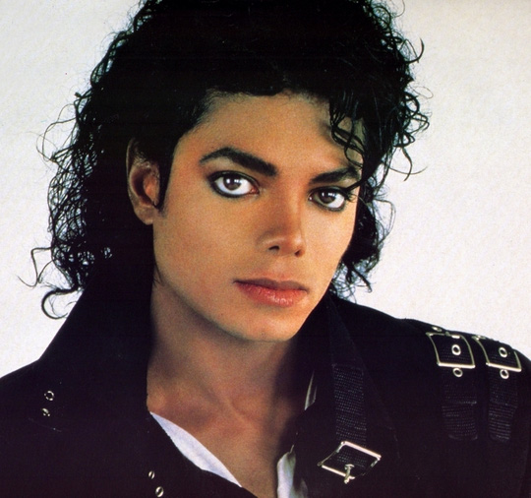
ANSWER
MICHAEL JACKSON
SINGER,
SONGWRITER,
DANCER
www.phuongnam.edu.vn

Slide 4
ANSWER
EMMA WATSON
ACTRESS,
ACTIVIST,
MODEL
www.phuongnam.edu.vn

Slide 5
ANSWER
MARK ZUCKERBERG
PROGRAMMER,
FACEBOOK CO-FOUNDER
www.phuongnam.edu.vn

Slide 6
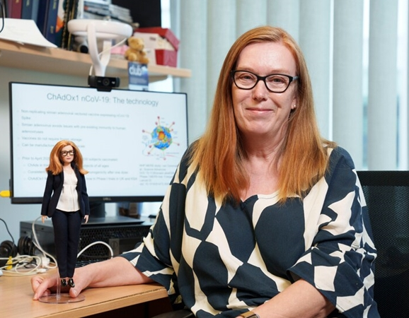
ANSWER
SARAH GILBERT
VACCINOLOGIST,
CO-FOUNDER OF
VACCITECH*
*Vaccitech: a biotechnology business that creates vaccines for catching illnesses and cancers
www.phuongnam.edu.vn

Slide 7
www.phuongnam.edu.vn

Slide 8
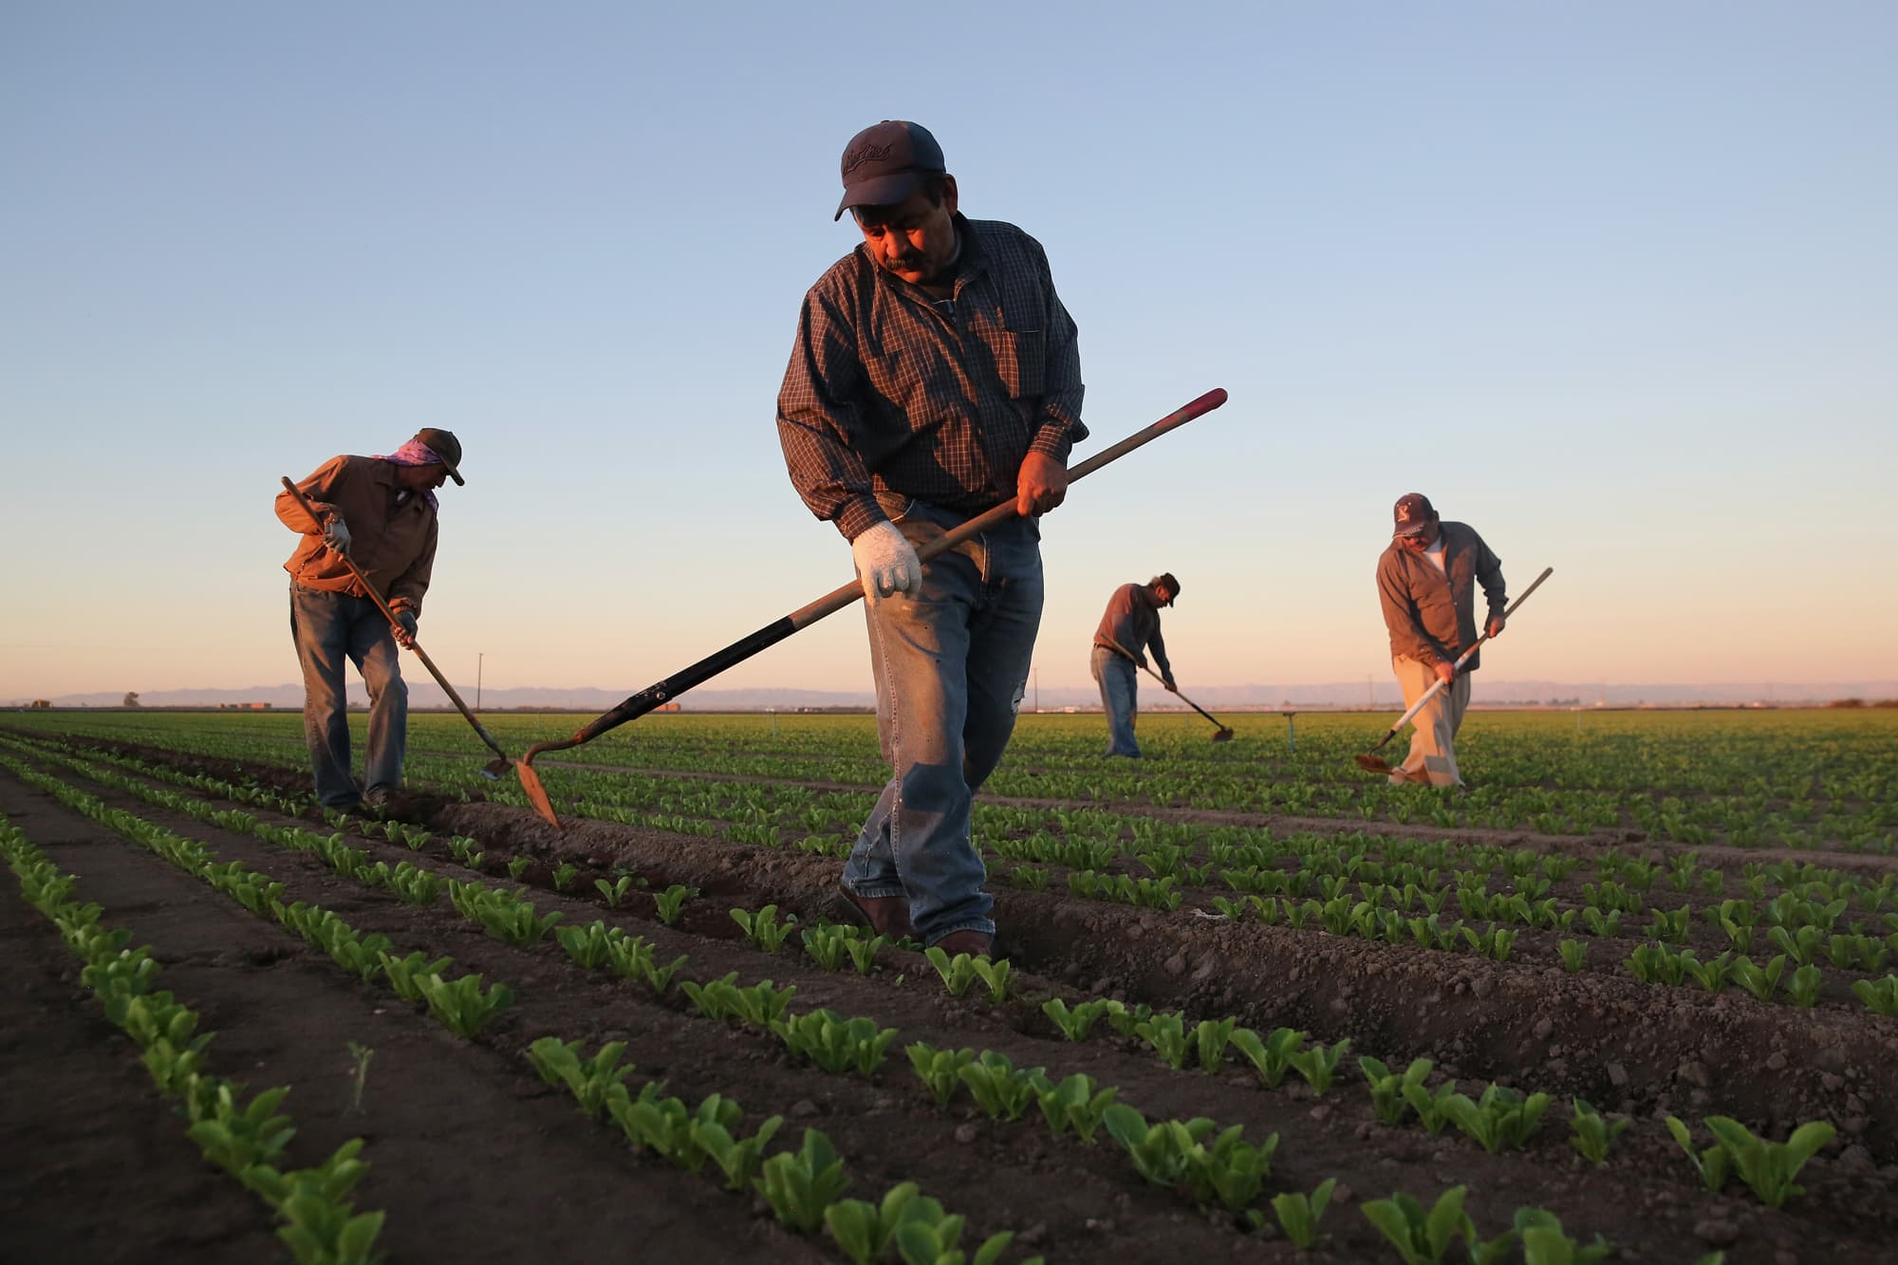
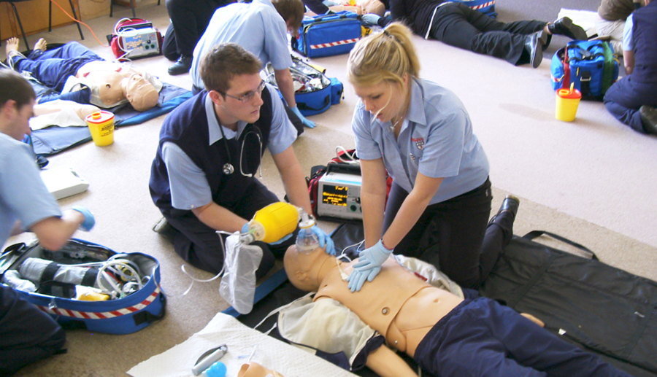
Vocabulary: JOBS (1)
architect /ˈɑːkɪtekt/
a person whose job is designing buildings
cleaner /ˈkliːnə(r)/
a person to clean other people’s houses or offices
dentist /ˈdentɪst/
a person whose job is to take care of people’s teeth
engineer /ˌendʒɪˈnɪə(r)/
a person whose job involves designing and building machines, roads, bridges,
farm worker /fɑːm ˈwɜːkə(r)/
a person who works, especially one who does a particular kind of work
hairdresser /ˈheədresə(r)/
a person whose job is to cut, wash and shape hair
paramedic /ˌpærəˈmedɪk/
a person whose job is to help people who are sick or injured, not a doctor or a nurse
www.phuongnam.edu.vn

Slide 9
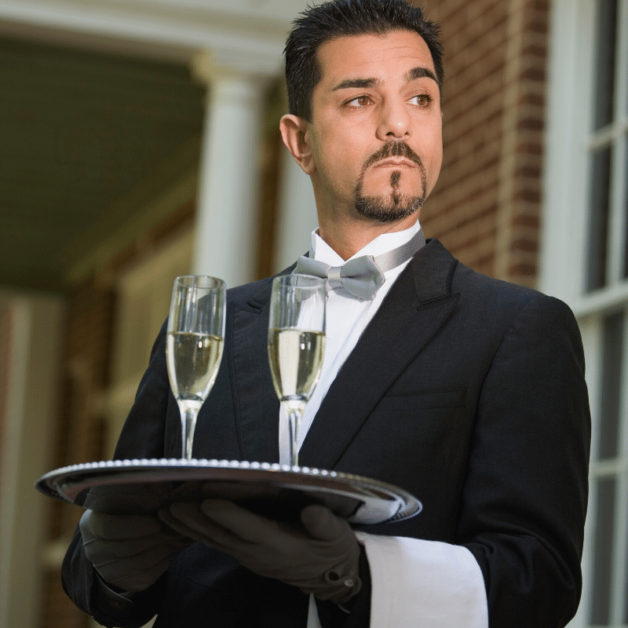
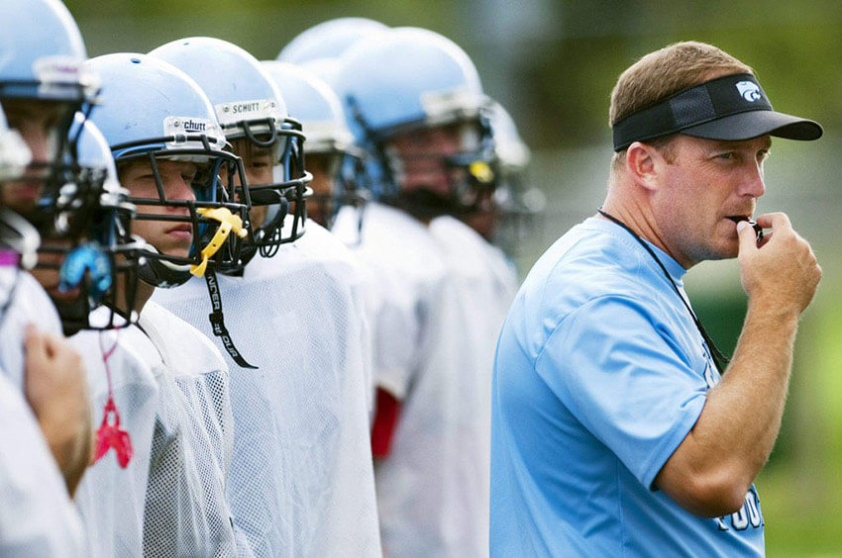
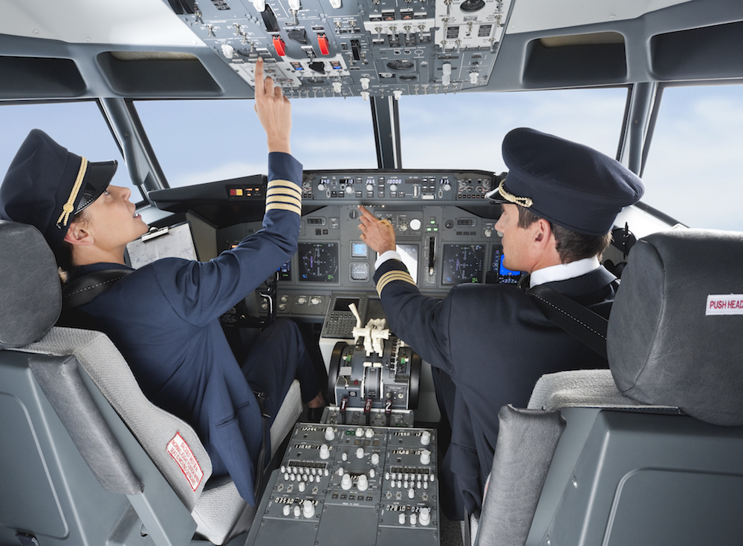
Vocabulary: JOBS (2)
pilot /ˈpaɪlət/
a person who operates the controls of an aircraft, especially as a job
programmer /ˈprəʊɡræmə(r)/
a person whose job is writing computer programs
receptionist /rɪˈsepʃənɪst/
a person to deal with people arriving at or phoning a hotel, a doctor’s surgery
sales assistant /seɪlz əˈsɪstənt/
a person to sell goods and help customers in a store
sports coach /spɔːts kəʊtʃ/
a person who trains a person or team in sport
travel agent /ˈtrævl eɪdʒənt/
a person or business to make plans for people to travel: buy tickets or arrange hotel rooms
waiter /ˈweɪtə(r)/
a man to serve customers at their tables in a restaurant
www.phuongnam.edu.vn

Slide 10
A
B
C
D
www.phuongnam.edu.vn

Slide 11
A
www.phuongnam.edu.vn

Slide 12
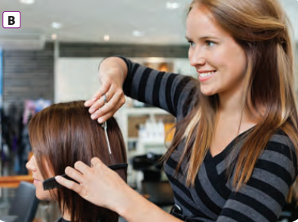
B
www.phuongnam.edu.vn

Slide 13
C
www.phuongnam.edu.vn

Slide 14
D
www.phuongnam.edu.vn

Slide 15
www.phuongnam.edu.vn

Slide 16
Adjectives of describing jobs
creative /kriˈeɪtɪv/
the use of skill and the imagination to produce something new or a work of art
challenging /ˈtʃælɪndʒɪŋ/
difficult in an interesting way that tests your ability
repetitive /rɪˈpetətɪv/
saying or doing the same thing many times, so that it becomes boring
rewarding /rɪˈwɔːrdɪŋ/
worth doing; that makes you happy because you think it is useful or important
stressful /ˈstresfl/
causing a lot of worry
tiring /ˈtaɪərɪŋ/
making you feel the need to sleep or rest
varied /ˈverid/
of many different types
www.phuongnam.edu.vn

Slide 17
www.phuongnam.edu.vn

Slide 18
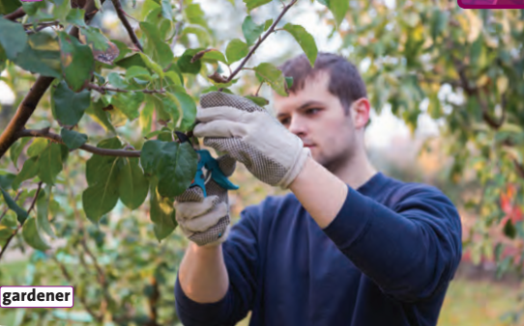
A
A gardener works outdoor
=> ...
www.phuongnam.edu.vn

Slide 19
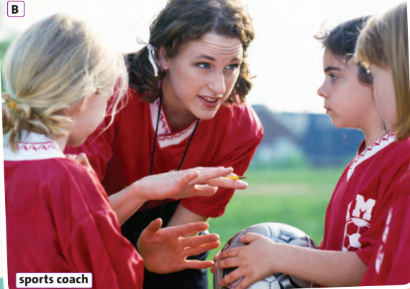
B
A sports coach works with children.
...
www.phuongnam.edu.vn

Slide 20
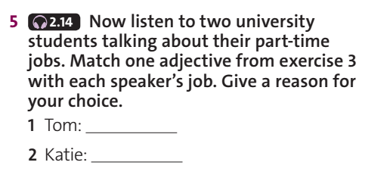
repetitive
rewarding
www.phuongnam.edu.vn

Slide 21
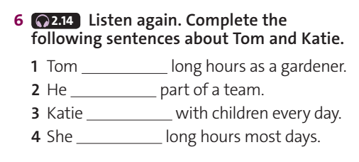
didn’t work
wasn‘t
worked
worked
www.phuongnam.edu.vn

Slide 22
7. Which sentence is true for you?
A. I don’t mind working long hours
B. I want to work nine-to-five
6. Which sounds better?
A. Sitting at a desk for most of the day
B. Being on your feet for most of the day
4. Which sentence is true for you?
A. I like being part of a team
B. I prefer working alone
2. Which do you prefer?
A. Working indoors
B. Working ourdoors
1. Which is more important to you?
A. Doing a chalenging and rewarding job
B. Earning a lot of money
5. Do you want a job that involves dealing with the public and/or serving customers?
A.Yes
B. No
C. I don’t mind
3. Do you want a job that involves travelling a lot?
A.Yes
B. No
C. I don’t mind
www.phuongnam.edu.vn

Slide 23
01
Homework
02
03
1. Learn by heart vocabulary
2. Practice talking about jobs
3. Do exercise in the workbook
4. Prepare U5-B (P.60)
04
?
05
06

Slide 24
www.phuongnam.edu.vn

Slide 25
Thank you!
CTCP ĐẦU TƯ VÀ PHÁT TRIỂN GIÁO DỤC PHƯƠNG NAM

